Slide 1
Face Recognition using Adaptive Sparse Representations
Domingo Mery
With collaboration of
Erick Svec, Ruben Mitnik, Tomas Larrain,
Roberto Rosenthal, Daniel Heinsohn
MACHINE INTELLIGENCE GROUP
DEPARTMENT OF COMPUTER SCIENCE
CATHOLIC UNIVERSITY OF CHILE
BiometryCloud
2014

Slide 2
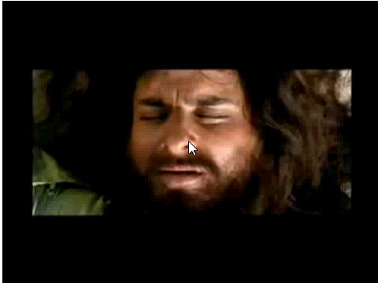
Notes:
Castaway

Slide 3
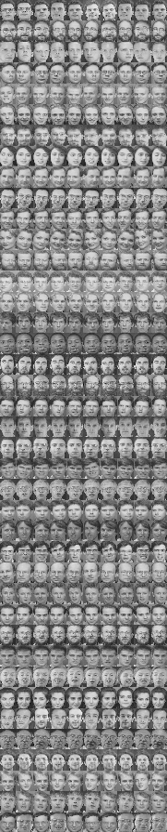

Face Recognition
Enrollment
Test image
Learning Process
Testing Process
John

Slide 4
Face Recognition using Adaptive Sparse Representations
Domingo Mery
With collaboration of
Erick Svec, Ruben Mitnik, Tomas Larrain,
Roberto Rosenthal, Daniel Heinsohn
MACHINE INTELLIGENCE GROUP
DEPARTMENT OF COMPUTER SCIENCE
CATHOLIC UNIVERSITY OF CHILE
BiometryCloud
2014
Notes:
Unconstrained conditions including variability in ambient lighting, pose, expression, face size and distance from the camera

Slide 5
Motivation

Slide 6
Motivation
Occluded parts do not bring any information of the subject.

Slide 7

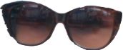
Motivation
Occluded parts do not bring any information of the subject.
➔ Only not-occluded parts should be considered by face recognition algorithm.
Face Recognition
Algorithm

Slide 8
Motivation
2) There are parts of the face that are more relevant than other parts.

Slide 9

Motivation
2) There are parts of the face that are more relevant than other parts.
➔ Relevant parts of each subject are subject-dependent.
Subject i
Unsupervised
Learning
Model of
Subject i
Notes:
Birthmarks, moles, large eyebrows, to name but a few

Slide 10
Motivation
3) Face images are not perfectly aligned.

Slide 11
Motivation
3) Face images are not perfectly aligned.
Feature should be extracted in random positions… and selected!
Query Image
Selection
Face
Recognition
Algorithm

Slide 12
Motivation
4) Face image can be subdivided into ‘sub-expressions’
It should be better to look for similar ‘sub-expressions’ (instead of similar images)
Query Image

Slide 13
Motivation
4) Face image can be subdivided into ‘sub-expressions’
It should be better to look for similar ‘sub-expressions’ (instead of similar images)
Gallery Images
Query Image

Slide 14
Motivation
4) Face image can be subdivided into ‘sub-expressions’
It should be better to look for similar ‘sub-expressions’ (instead of similar images)
Gallery Images
Query Image

Slide 15
Motivation
4) Face image can be subdivided into ‘sub-expressions’
It should be better to look for similar ‘sub-expressions’ (instead of similar images)
Gallery Images
Query Image

Slide 16
Proposed Algorithm
LEARNING PART 1
TESTING PART 2

Slide 17




Proposed Algorithm
LEARNING PART 1
subject 1
subject i
subject k
. . . . . .
:
:
:
1. Acquisition of Gallery Images

Slide 18
Proposed Algorithm
LEARNING PART 1
subject 1
subject i
subject k
. . . . . .
:
:
:
2. Extraction of Patches

Slide 19
Proposed Algorithm
LEARNING PART 1
subject 1
subject i
subject k
. . . . . .
:
:
:
3. Description
description
description
description

Slide 20
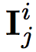
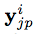
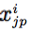
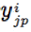
Proposed Algorithm
LEARNING PART 1
subject 1
subject i
subject k
. . . . . .
:
:
:
3. Description
of Image
description
description
description
patch 1
Description of
one patch
f
patch p
...
x
f
patch m
...
f
y
description z
...
...
d
( , )
...
w
...
location
2
w
m

Slide 21
Proposed Algorithm
LEARNING PART 1
subject 1
subject i
subject k
extraction
of patches
. . . . . .
:
:
:
description
description
description
dictionaries
for subject 1
dictionaries
for subject i
dictionaries
for subject k
4. Learning Dictionaries

Slide 22
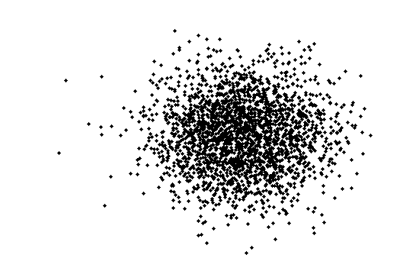
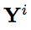
Proposed Algorithm
LEARNING PART 1
Description of
all patches
of subject i
Description of
one patch

Slide 23
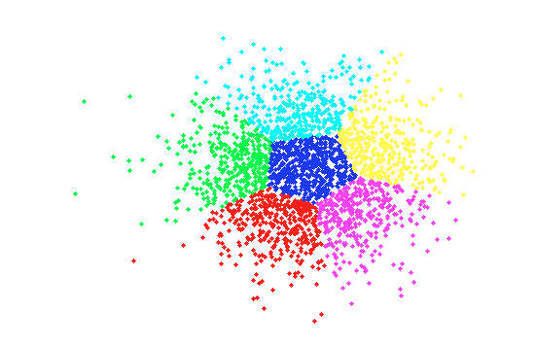
Proposed Algorithm
LEARNING PART 1
Description of
all patches
of subject i
Q parent clusters
K-Means with Q clusters

Slide 24
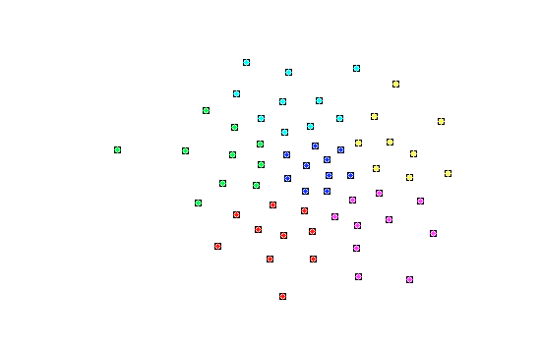
Proposed Algorithm
LEARNING PART 1
Description of
all patches
of subject i
R child clusters
K-Means with R clusters in
each parent cluster

Slide 25
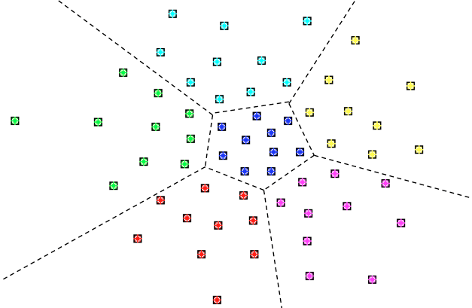
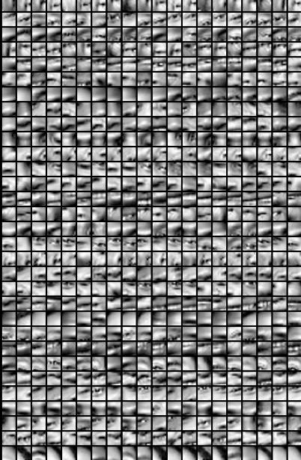
Proposed Algorithm
LEARNING PART 1
subject i
Q
Dictionaries
for subject i
R

Slide 26

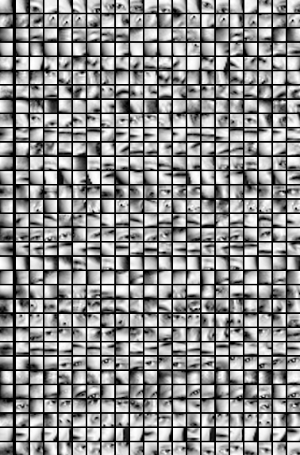
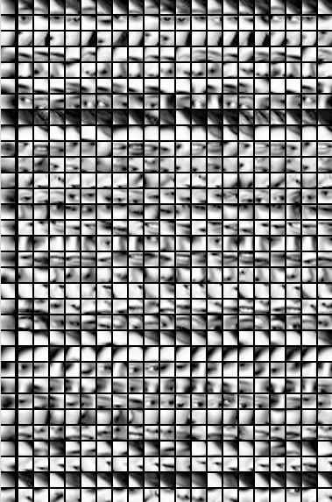
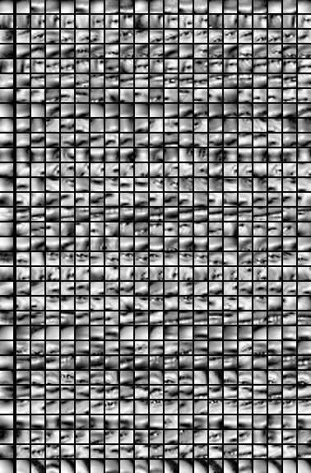
Proposed Algorithm
LEARNING PART 1
subject 1
Subject 2
subject i
subject k
… …

Slide 27
Proposed Algorithm
LEARNING PART 1
subject 1
subject i
subject k
extraction
of patches
. . . . . .
:
:
:
description
description
description
dictionaries
for subject 1
dictionaries
for subject i
dictionaries
for subject k

Slide 28

Proposed Algorithm
TESTING PART 2
subject 1
subject i
subject k
extraction
of patches
. . . . . .
:
:
:
description
description
description
dictionaries
for subject 1
dictionaries
for subject i
dictionaries
for subject k
LEARNING
TESTING
for each test patch
classification
class
:
:
description
vote
score
majority vote
query image
ID
for all test patches

Slide 29
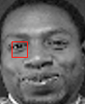

Proposed Algorithm
TESTING PART 2
y
[patch]
[query image]
Subject 2
has no match
subject 1 subject 2
subject i
subject k

Slide 30
Proposed Algorithm
TESTING PART 2
y
[patch]
[query image]
Subject 2
has no match
subject 1
subject i
subject k

Slide 31
Proposed Algorithm
TESTING PART 2
y
[patch]
[query image]
subject 1
subject i
subject k

Slide 32
Proposed Algorithm
TESTING PART 2
y
[patch]
[query image]
Adaptive
Dictionary
for y
A(y) =
subject 1
subject i
subject k

Slide 33
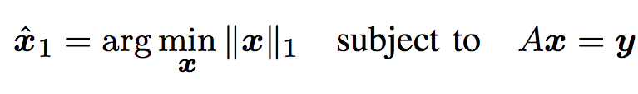
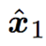
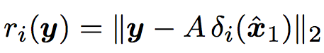
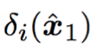
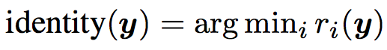
Proposed Algorithm
TESTING PART 2
y
How we can classify the patch ‘y’?
[patch]
[query image]
We look for a sparse representation of y using l1-minimization approach:
We compute the residuals:
The class of y is :
class(y)
i

Slide 34
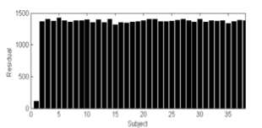
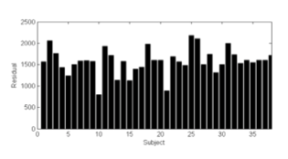
Proposed Algorithm
TESTING PART 2
y
How to compute the scores?
[patch]
[query image]
Score = 0.8
Score = 0.1
We extract several random patches from the query image.
We sort them using their score, and select the patches with the highest score values (i.e. the ‘best’ patches).
We classify the query image according to the majority vote of the individual classification of the best patches.

Slide 35
Proposed Algorithm
TESTING PART 2
subject 1
subject i
subject k
extraction
of patches
. . . . . .
:
:
:
description
description
description
dictionaries
for subject 1
dictionaries
for subject i
dictionaries
for subject k
LEARNING
TESTING
(for each test patch)
:
:
:
:
description
best
dictionaries
SRC
selection
majority vote
ID
query image
(for all test patches)

Slide 36
Experiments
6 Databases:
ORL
Yale
Cas-Peal
RR (new)
AR
LFW
4 Algorithms:
NBNN
SRC
TPTSR
ASR (ours)

Slide 37
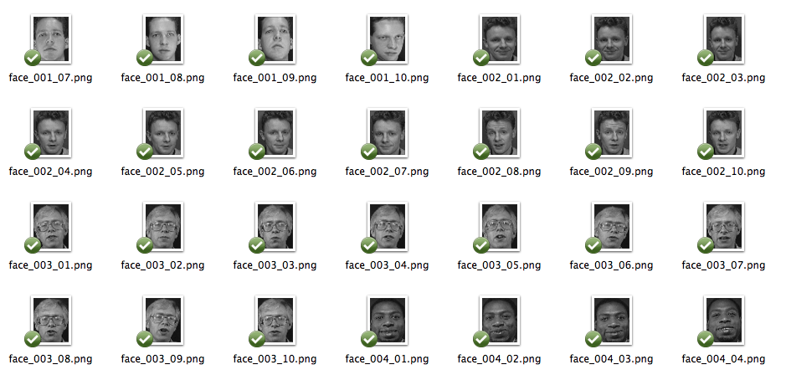
Database ORL

Slide 38
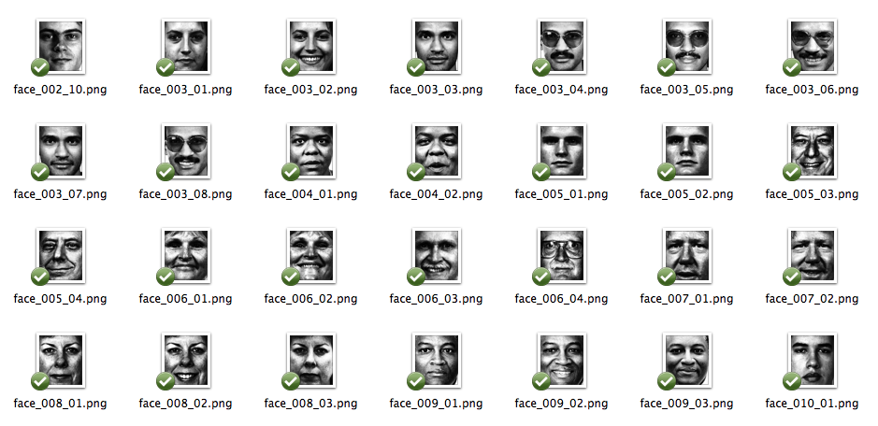
Database Yale

Slide 39
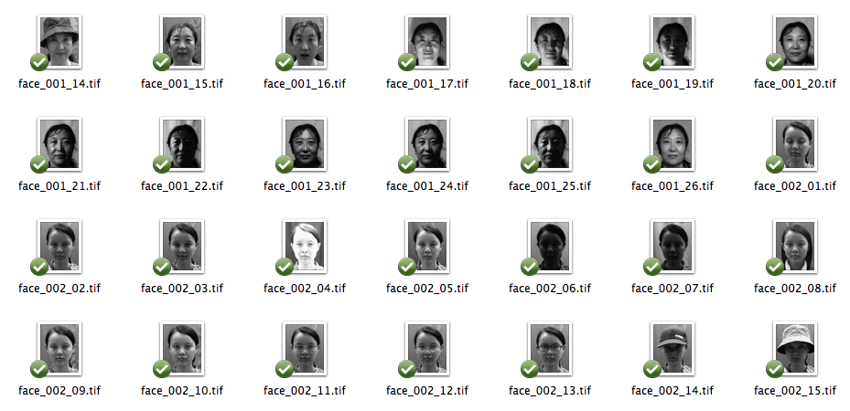
Database Cas

Slide 40
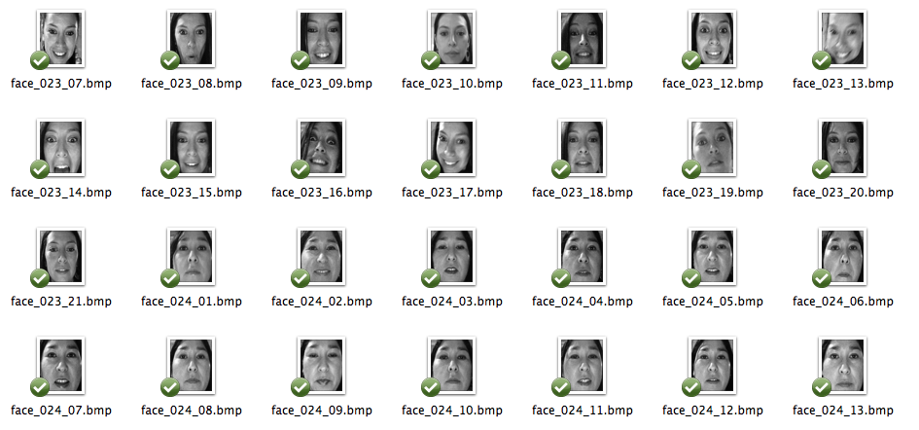
Database RR

Slide 41
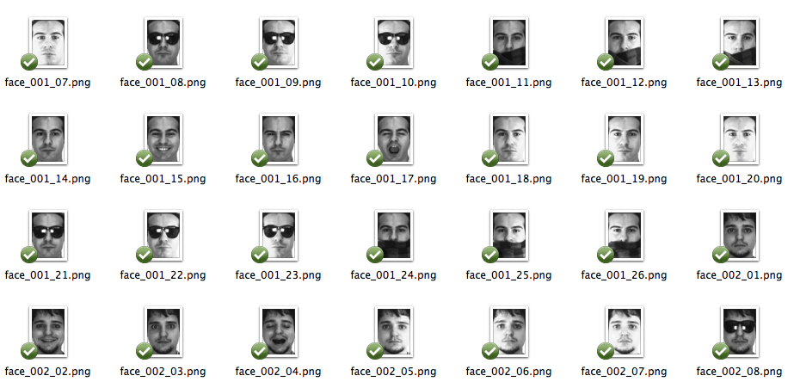
Database AR

Slide 42
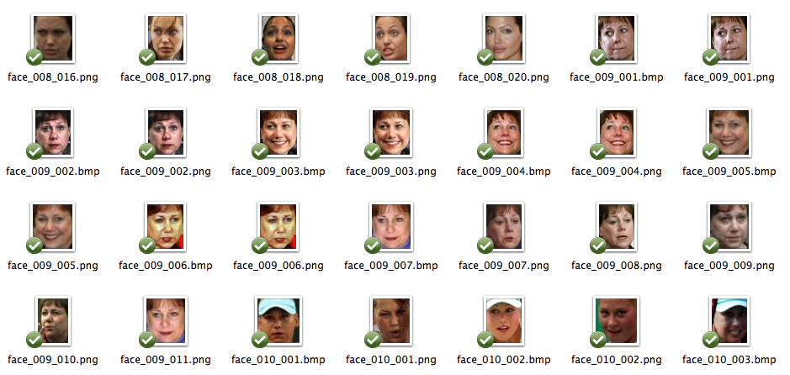
Database LFW

Slide 43
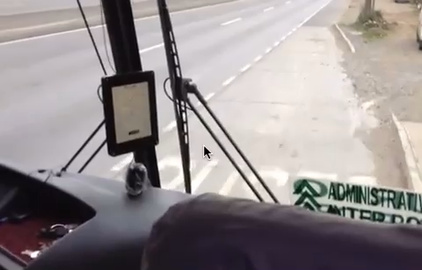
RR Database

Slide 44
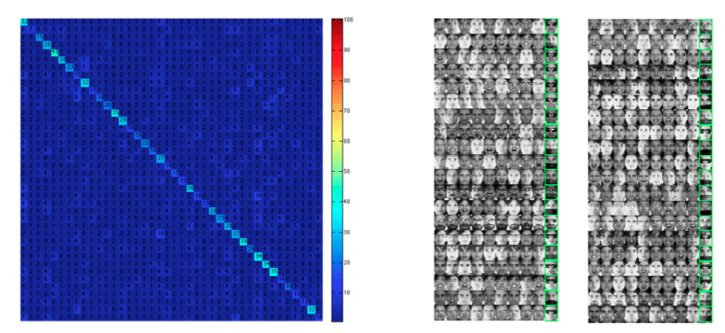
Recognition with real occlusion

Slide 45
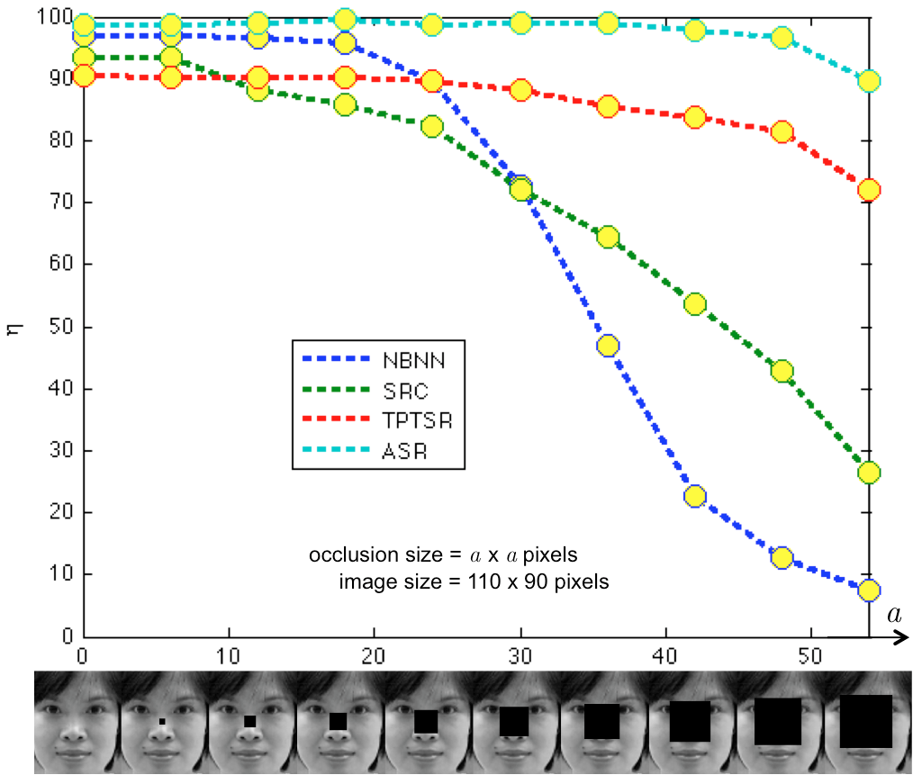

Slide 46
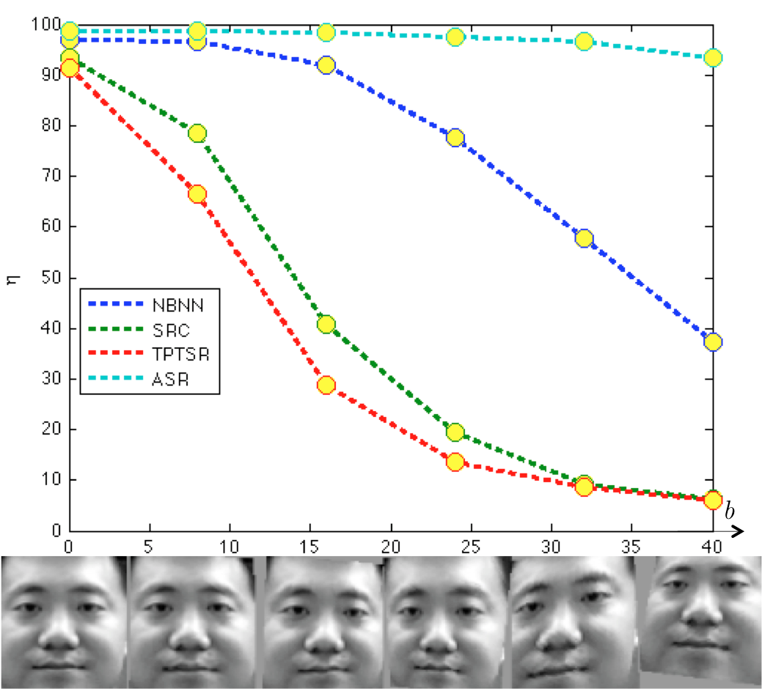

Slide 47
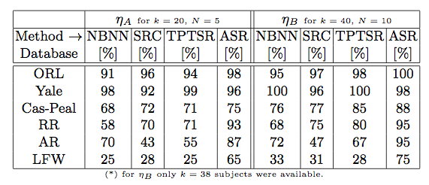
Comparison with other methods

Slide 48
DEMO

Slide 49
Face Recognition using Adaptive Sparse Representations
Domingo Mery
With collaboration of
Erick Svec, Ruben Mitnik, Tomas Larrain,
Roberto Rosenthal, Daniel Heinsohn
MACHINE INTELLIGENCE GROUP
DEPARTMENT OF COMPUTER SCIENCE
CATHOLIC UNIVERSITY OF CHILE
BiometryCloud
2014

Slide 50
Face Recognition
Image Acquisition
Preprocessing
BD
Segmentation
Feature
extraction
Clasification
Our boss

Slide 51

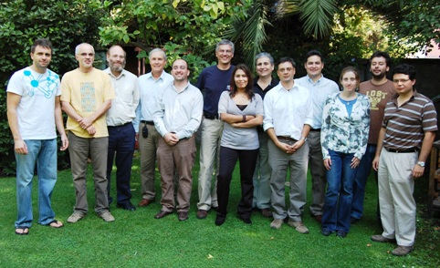
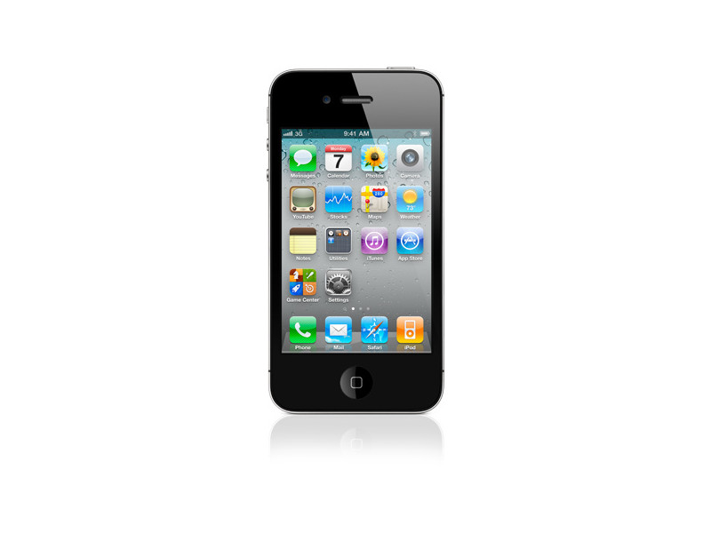


Face Recognition
Image Acquisition
Preprocessing
Feature 1
420
Feature 2
310
BD
Feature 3
180
:
:
Face Detection
Feature
extraction
Clasification
Our boss

Slide 52
Sparse Representation Classification (SRC)
Wright, et. Al. Robust Face Recognition via Sparse Representation. PAMI 2009
In the training set there are k subjects.
For each subject we have n training images.
In this example there are 40 subjects with 9 images each.
Each image is downsampled to h x w = m pixels
Each downsampled image is represented as a vector v of m elements (by stacking its columns)
:
:
v =

Slide 53
Sparse Representation Classification (SRC)
Wright, et. Al. Robust Face Recognition via Sparse Representation. PAMI 2009
For each subject i (for i=1,…k) we have a dictionary
A_{i} = [v_{i1}, v_{i2}, …, v_{in}]
We define a new matrix A by concatenating all individual dictionaries
A = [A₁, A₂, …, A_{k}]
The size of A is m x (nk)
A is normalized (its columns have unit l² norm).

Slide 54

Sparse Representation Classification (SRC)
Wright, et. Al. Robust Face Recognition via Sparse Representation. PAMI 2009
How a test image is classified?
A new test image I^{t} is represented as vector y of m elements (using the same representation of the training images)
Now, we look for a sparse representation of y using l1-minimization approach:
I^{t}
We compute the residuals:
The identity of I^{t} is :
i

Slide 55
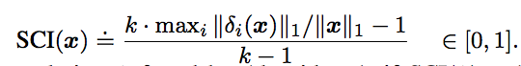
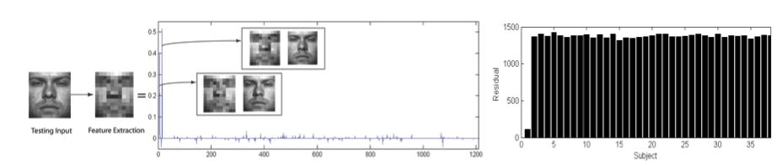
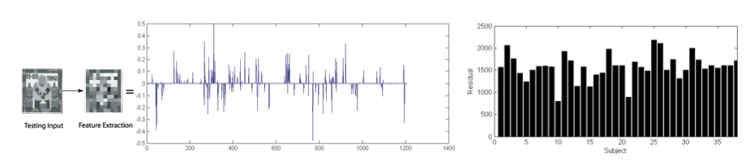
Sparse Representation Classification (SRC)
Wright, et. Al. Robust Face Recognition via Sparse Representation. PAMI 2009
How good is the classification?
We use the Sparsity Concentration Index (SCI)

